Slide 1
Local Area Networks
LANs

Slide 2
Building Blocks of Local Area Networks
Network Interface Card built in the host
‘Intelligent’ hardware
runs Data Link Control ( MAC )protocol
For each type of physical media supported, NIC is different
e.g. Ethernet NIC for wired interface is different from Wi-Fi interface
Link protocol for each type of physical interface is different
Physical media to connect to other hosts or interconnecting devices
Wire
Twisted pair
Coaxial cable
Fiber
Wireless
Radio
Optical ( Infrared )

Slide 3
Building Blocks of Local Area Networks
3. Interconnecting devices
Hubs/ Repeaters
4. Inter-LAN device
Bridge / Switch
5. Software / Network operating system at every host

Slide 4
Hubs
Hubs are essentially physical-layer repeaters:
bits coming from one link go out all other links
at the same rate
no frame buffering
no CSMA/CD at hub: adapters detect collisions
provides net management functionality
twisted pair
hub

Slide 5
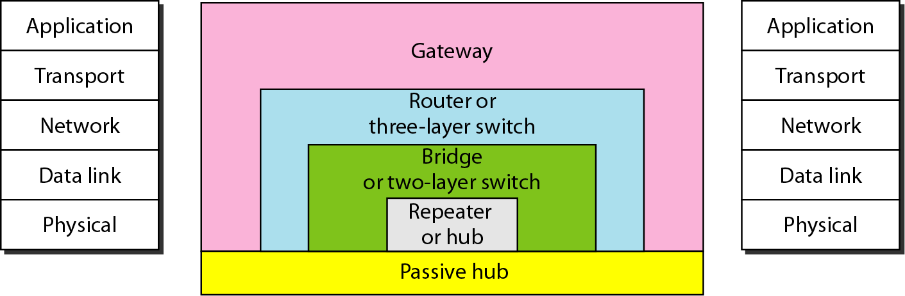
Figure 15.1 Five categories of connecting devices

Slide 6
Interconnecting with hubs
Backbone hub interconnects LAN segments
Extends max distance between nodes
But individual segment collision domains become one large collision domain
Can’t interconnect 10BaseT & 100BaseT
hub
hub
hub
hub

Slide 7
Institutional network
mail server
to external
network
router
web server
switch
IP subnet
hub
hub
hub

Slide 8
Ethernet Switch

Slide 9
3 main functions of Ethernet Switch
Traffic segregation at link layer
Separates collision ( broadcast) LAN segments
Improves overall throughput of the LAN
Connects LANS with different types of physical media
Example
Copper based LAN to Fiber based LAN
Wireless LAN to Wired LAN
Connects LANs with different bandwidth ( data rates), since switch is a ‘store and forward’ device.
Example
100 Mbps LAN to 10Mbps LAN
Gigabit LAN to 10Mbps LAN

Slide 10
Ethernet switch
link-layer device: takes an active role
store, forward Ethernet frames
examine incoming frame’s MAC address, selectively forward frame to one-or-more outgoing links when frame is to be forwarded on segment, uses CSMA/CD to access segment
transparent
hosts are unaware of presence of switches
plug-and-play, self-learning
switches do not need to be configured

Slide 11



Switch: multiple simultaneous transmissions
hosts have dedicated, direct connection to switch
switches buffer packets
Ethernet protocol used on each incoming link, but no collisions; full duplex
each link is its own collision domain
switching: A-to-A’ and B-to-B’ can transmit simultaneously, without collisions
A
C’
B
6
1
2
5
4
3
B’
C
A’
switch with six interfaces
(1,2,3,4,5,6)

Slide 12
Forwarding
switch
1
2
3
hub
hub
hub
How do determine onto which LAN segment to forward frame?
Looks like a routing problem...

Slide 13
Switch forwarding table
Q: how does switch know A’ reachable via interface 4, B’ reachable via interface 5?
A
C’
B
A: each switch has a switch table, each entry:
(MAC address of host, interface to reach host, time stamp)
looks like a routing table!
6
1
2
5
4
3
B’
C
A’
Q: how are entries created, maintained in switch table?
something like a routing protocol?
switch with six interfaces
(1,2,3,4,5,6)

Slide 14
Switch: self-learning
Source: A
Dest: A’
switch learns which hosts can be reached through which interfaces
when frame received, switch “learns” location of sender: incoming LAN segment
records sender/location pair in switch table
A
A A’
C’
B
6
1
2
5
4
3
B’
C
A’
MAC addr interface TTL
A
1
60
Switch table
(initially empty)

Slide 15
Switch: frame filtering/forwarding
when frame received at switch:
1. record incoming link, MAC address of sending host
2. index switch table using MAC destination address
3. if entry found for destination then {
if destination on segment from which frame arrived then drop frame
else forward frame on interface indicated by entry
}
else flood /* forward on all interfaces except arriving
interface */

Slide 16
Self-learning, forwarding: example
Source: A
Dest: A’
A
A A’
frame destination, A’, locaton unknown:
flood
C’
B
destination A location known:
6
1
2
A A’
A A’
A A’
A A’
selectively send
on just one link
A A’
5
4
3
B’
C
A’ A
A’
MAC addr interface TTL
A
1
60
switch table
(initially empty)
A’
4
60

Slide 17

Interconnecting switches
switches can be connected together
S₄
S₁
S₃
A
S₂
F
I
B
C
D
E
G
H
Q: sending from A to G - how does S₁ know to forward frame destined to F via S₄ and S₃?
A: self learning! (works exactly the same as in single-switch case!)

Slide 18
Self-learning multi-switch example
Suppose C sends frame to I, I responds to C
S₄
S₁
S₃
A
S₂
F
I
B
C
D
E
G
H
Q: show switch tables and packet forwarding in S₁, S₂, S₃, S₄

Slide 19
Institutional network
mail server
to external
network
router
web server
IP subnet

Slide 20
Switch: traffic isolation
switch installation breaks subnet into LAN segments
switch filters packets:
same-LAN-segment frames not usually forwarded onto other LAN segments
segments become separate collision domains
switch
collision domain
hub
hub
hub
collision domain
collision domain

Slide 21
Switches: dedicated access
Switch with many interfaces
Hosts have direct connection to switch
No collisions; full duplex
Switching: A-to-A’ and B-to-B’ simultaneously, no collisions
A
C’
B
switch
C
B’
A’

Slide 22
Switches vs. routers
application
transport
network
link
physical
both are store-and-forward:
routers: network-layer devices (examine network-layer headers)
switches: link-layer devices (examine link-layer headers)
both have forwarding tables:
routers: compute tables using routing algorithms, IP addresses
switches: learn forwarding table using flooding, learning, MAC addresses
datagram
frame
link
physical
frame
switch
network
link
physical
datagram
frame
application
transport
network
link
physical

Slide 23
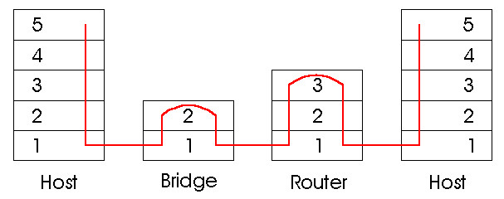
Switches vs. Routers
both store-and-forward devices
routers: network layer devices (examine network layer headers)
switches are link layer devices
routers maintain routing tables, implement routing algorithms
switches maintain switch tables, implement filtering, learning algorithms

Slide 24
Summary comparison

